Slide 1
DATASET
5.18 / 양정(YANG CHENG)

Slide 2
Spotify data
US
TOP10 artist-10
＜20w artist-random
CN
KO
JP
FR
TOP10 artist-10
＜20w artist-random
TOP10 artist-10
＜20w artist-random
TOP10 artist-10
＜20w artist-random
＜20w artist-random
TOP10 artist-10
데이터세트 설명
01
monthly listeners
List of singers
results = sp.search(q=artist_name, type='artist', limit=1)
Dataset(5W)
All songs
Balance
Data source：Spotify API，Genius API

Slide 3
데이터세트 설명
01
Balance：
Language distribution： Different countries have English songs, so English songs make up a relatively larger proportion.
Quality of national content coverage： Spotify has the most compre-hensive content in the United States, South Korea, and Japan, but it lacks local copyright support in China, resulting in incomplete or non-existent libraries for many Chinese singers, which affects data integrity.
Distribution of Song Counts： Popular singers (such as BTS) typically have dozens to hundreds of songs, while niche artists may release only a few singles. Even with the same number of people, the number of songs tends to favor top artists. Therefore, we will control the number of songs by the same singer and ensure that the number of popular and lesser-known songs is evenly distributed.

Slide 4
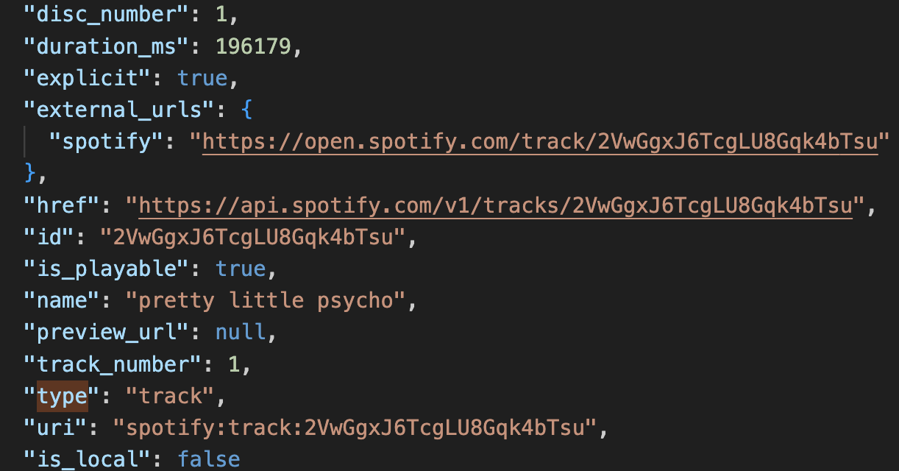
Top-Level Structure
spotify
popularity
image_url
genius_url
lyrics
artists （name，id，external_urls.spotify，uri）
available_markets
Progress
01
3W
2W+

Slide 5
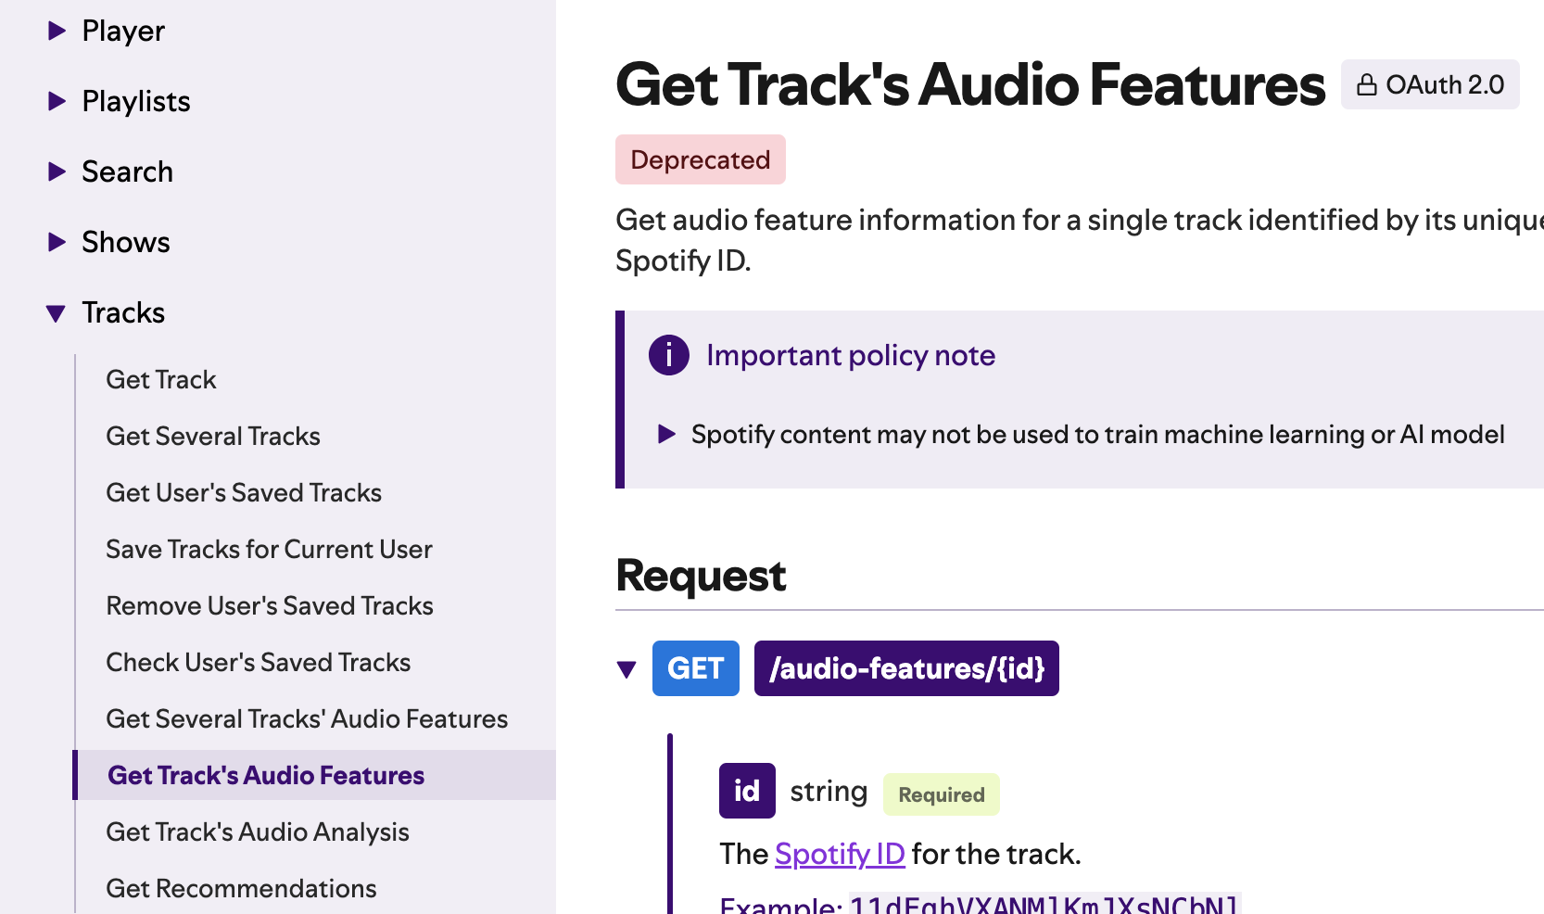
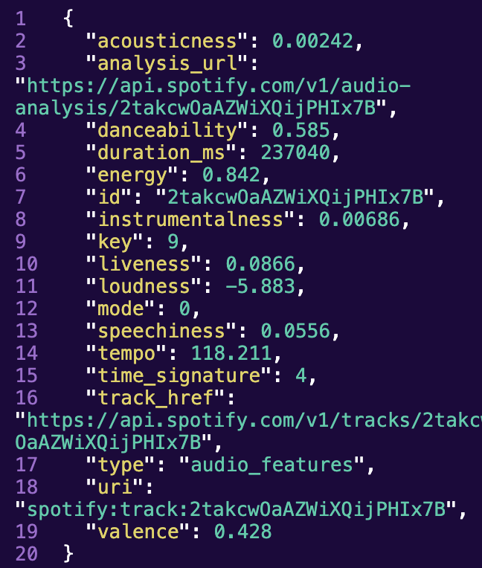
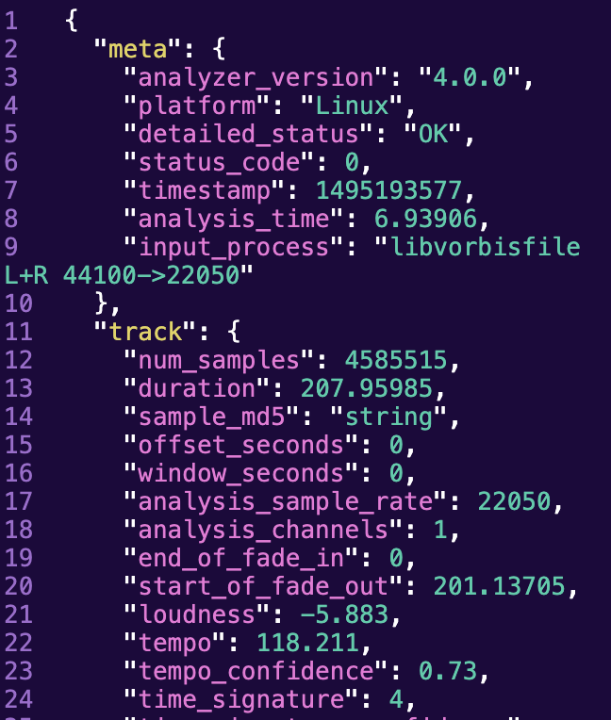
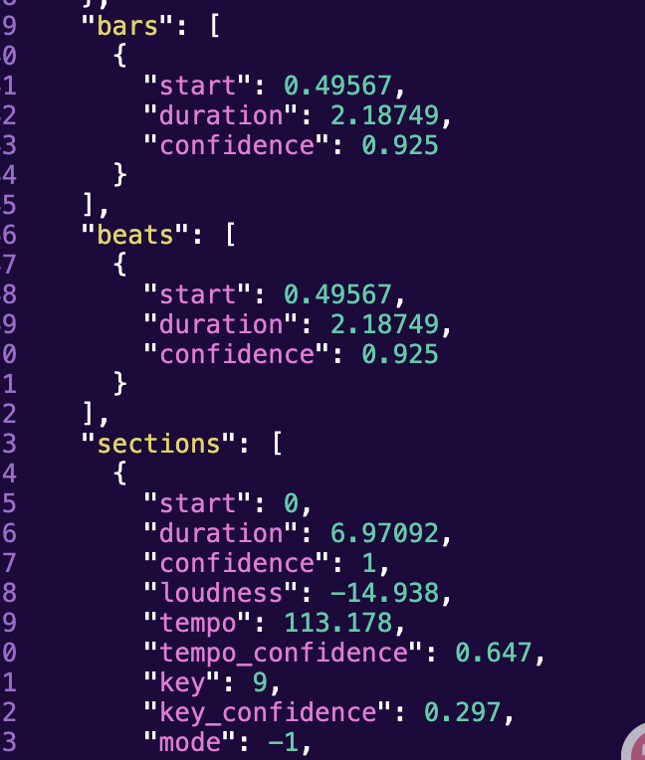
Problem
01
https://www.reddit.com/r/spotifyapi/comments/1h1o2m9/spotify_api_changes/

Slide 6
Problem
01
1. When Genius crawls lyrics, some songs cannot be crawled.
2. There is a random error in crawling lyrics links.
3.Spotify and Genius generally have poor support for Chinese songs.

Slide 7
감사합니다.
Date / name

